Slide 1
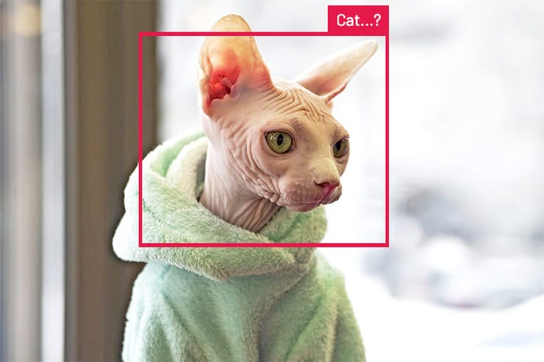

Accelerating Edge ML with Edge Impulse
Rob Lauer
Director of Developer Relations

Slide 2
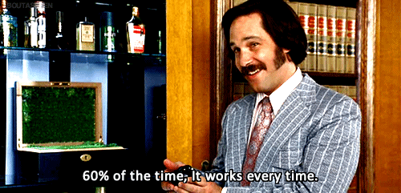

Slide 3
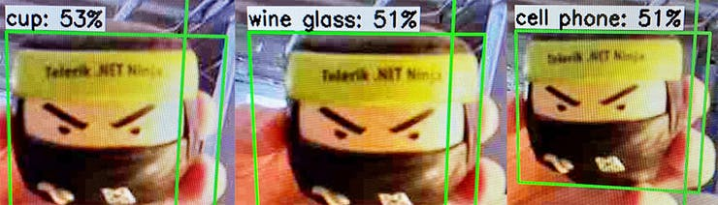

Slide 4
Machine learning is the study of computer algorithms that improve automatically through experience and by the use of data. It is seen as a part of artificial intelligence.

Slide 5
Machine learning lets computers learn from data…versus being explicitly told what to do.

Slide 6
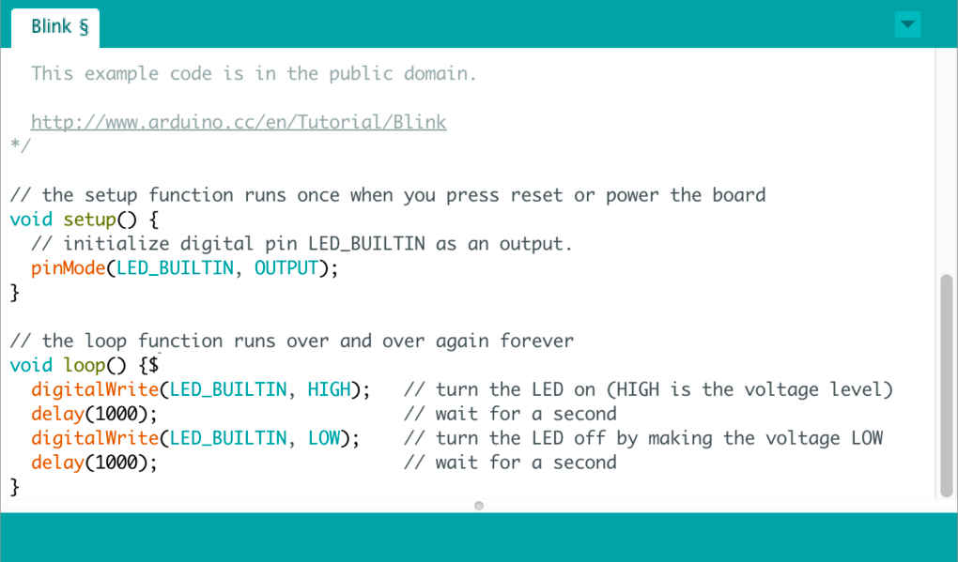
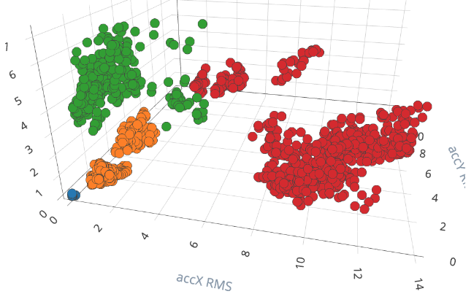

Paradigm Shift
Traditional Programming (Strict)
Machine Learning (Flexible)
Rules
Answers
Data
Data
vs
Adapt the rules
Collect more data
Answers
Rules

Slide 7
Edge Computing
+
Machine Learning

Slide 8






Benefits of Edge ML
Innovation
Privacy
Power
Add new differentiating features, become a market leader by standing out from your competition
Data stays on the device, gets processed locally and drives remote alerts, notifications, and actions
Stay operational for longer periods of time
Cost
Reliability
Latency
Save on storage and compute costs by not sending raw data constantly to the cloud
Be operational in low connectivity environments
Process data real-time on the edge device, without having to wait for a response back from the cloud

Slide 9

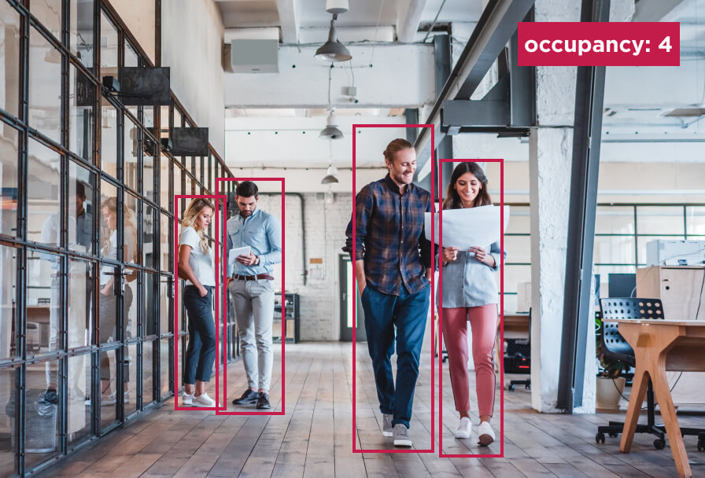
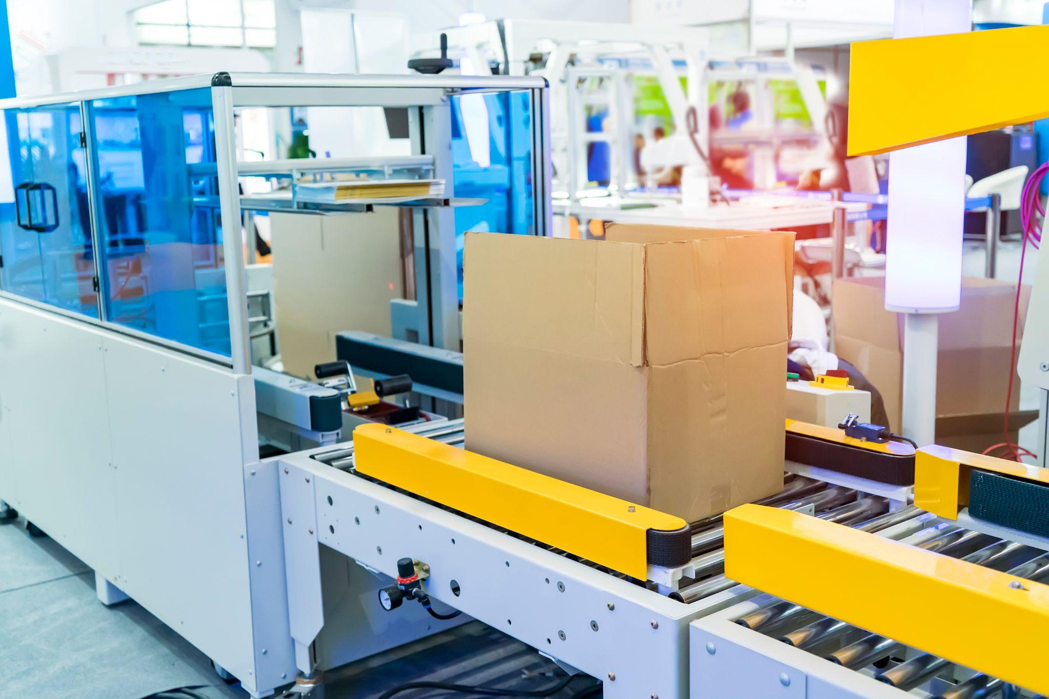

Edge ML Solutions
Wearables
Spaces
Industry
Logistics
Voice Commands
Health Prediction
Activity Detection
Gesture Recognition
Acoustic Event Detection
Voice Commands
Appliance Smart Sensing
Fire Detection
People Counting
HVAC Maintenance
Acoustic Event Detection
PDM - Motors
Power Grid Monitoring
Worker Safety
Manufacturing Quality
Analog Meter Reading
Smart Robotics
Asset Tracking
Worker Safety
Smart Cameras
Battery Monitoring
Copyright © Edge Impulse Inc.

Slide 10

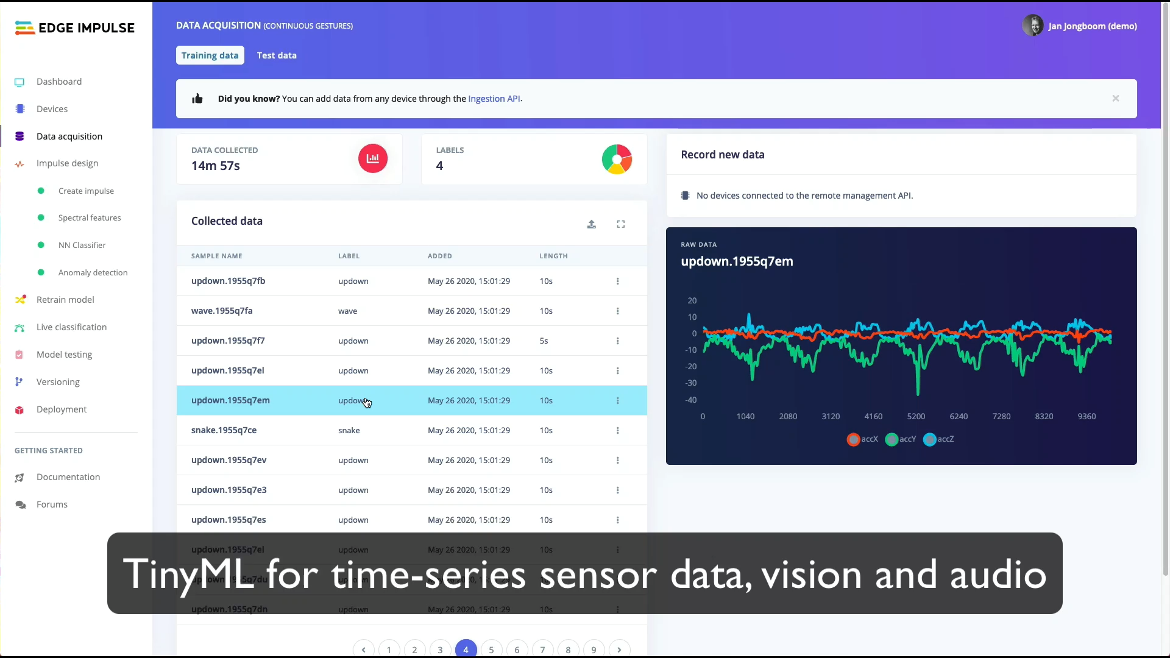

Slide 11

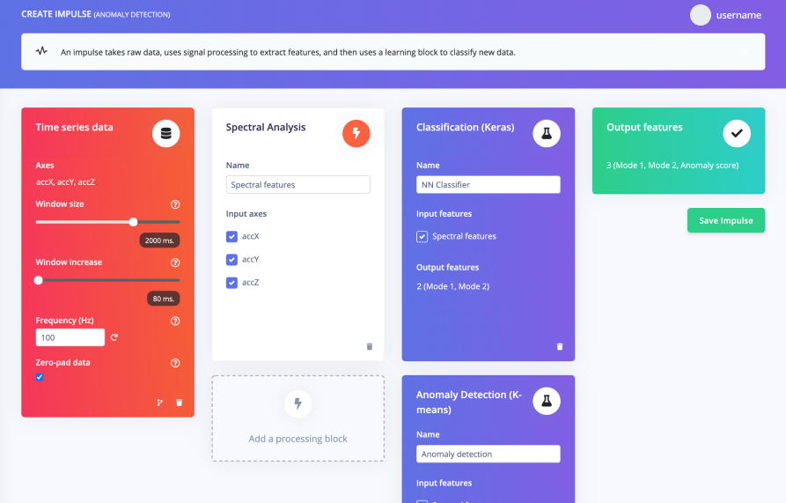
The developer-first edge ML platform
No royalty, no impact on BOM
Your IP, stays your IP
Total explainability, no black boxes

Slide 12
How Edge Impulse Solves Edge ML Challenges
99% of sensor & device data is discarded
Accelerate next gen IoT products and solutions turning data from any edge device into actionable insights
Current ML tools are not designed for edge
Enable developers enterprise-wide to rapidly build ML solutions natively for edge devices, amplifying your ML experts
87% of AI/ML projects fail due to infra complexity
MLOps infrastructure from data collection to edge deployment, for enterprise data science and ML teams, with leading integrations
Difficulties in building smart product experiences
Build innovative experiences with ML with ease, leading to growth and competitive differentiation

Slide 13

Any sensor, any data, any use case
Ultra low power
Low-end MCU
High-end MCU
NPU
MPU
GPU
Memory
Anomaly detection
10kB
Sensor data classification
18kB
Audio classification
50kB
Image classification
256kB
Object detection complex voice processing
1MB+
Video classification
1GB+
Sensor
Audio
Image
Video

Slide 14






Develop Edge ML Applications with Edge Impulse
Edge device
Collect
Design
Test
Deploy
Rapidly build custom datasets
Develop models & algorithms
Accurately test model performance
Easily deploy on any edge target

Slide 15
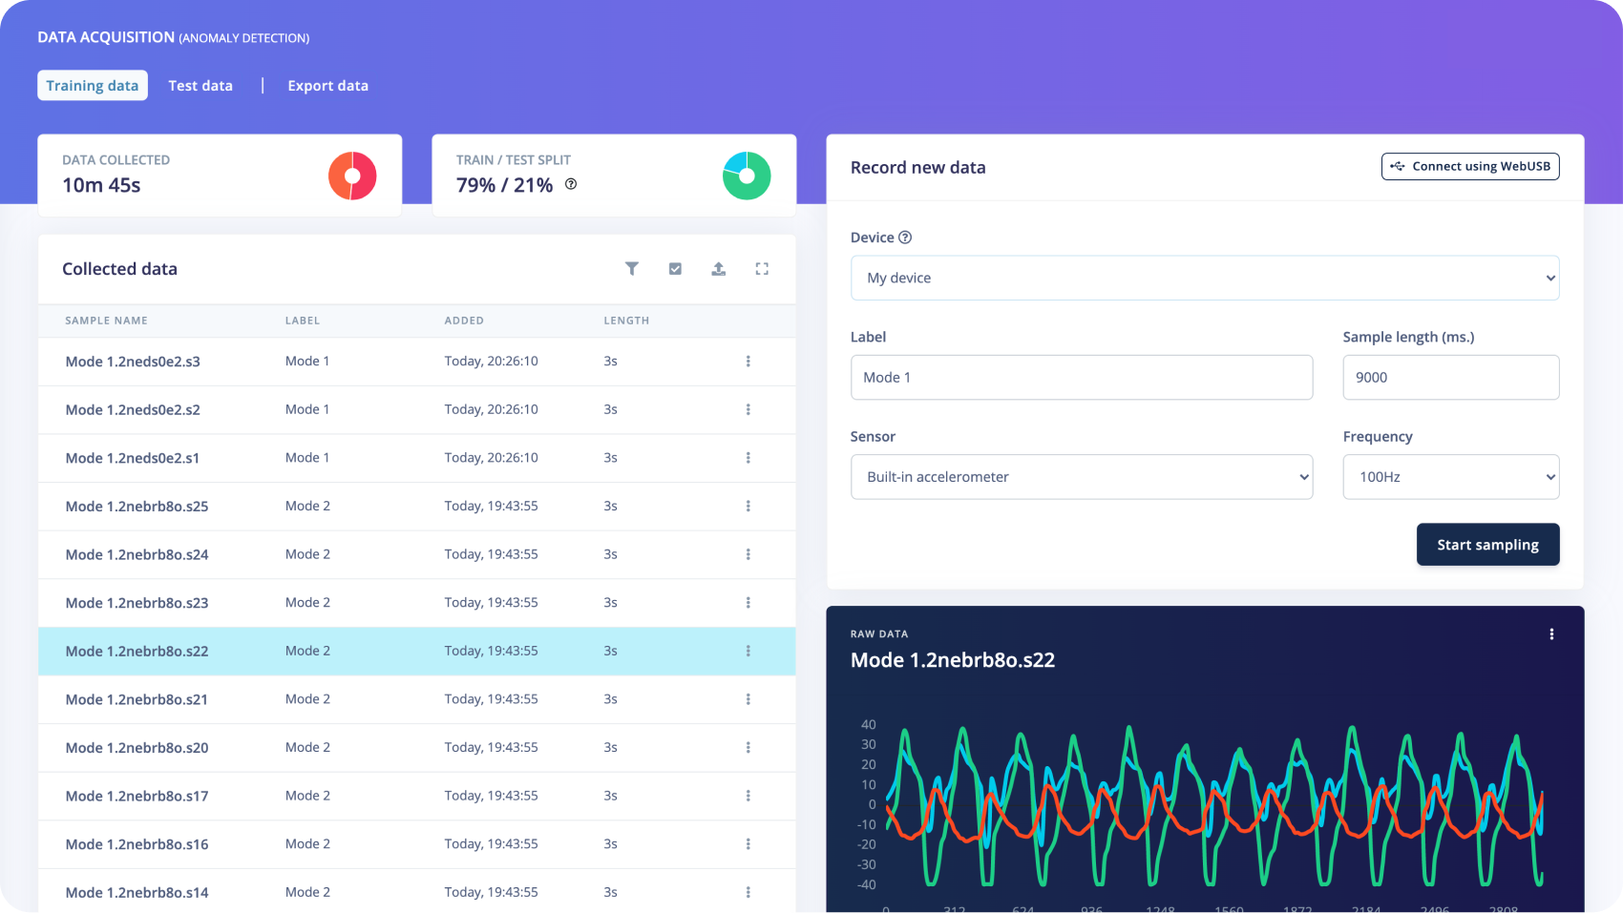
Build valuable datasets at scale
Collect
Data science infrastructure
Auto-labeling tools
Integrations with data science tools
Data traceability and quality control
Secure data exchange portal

Slide 16
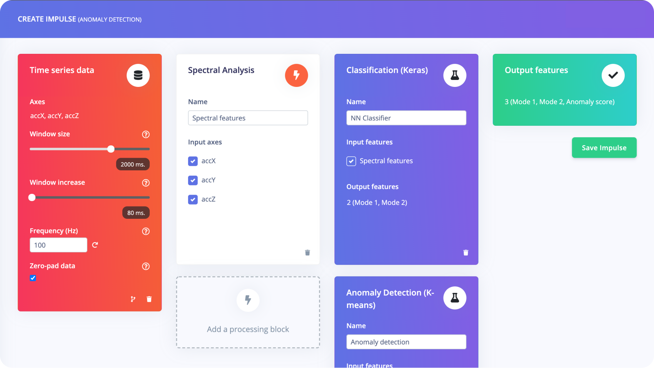
Advanced algorithm and ML expertise
Design
Advanced algorithm and DSP expertise
No black boxes
Explainable AutoML
Collaboration between teams

Slide 17
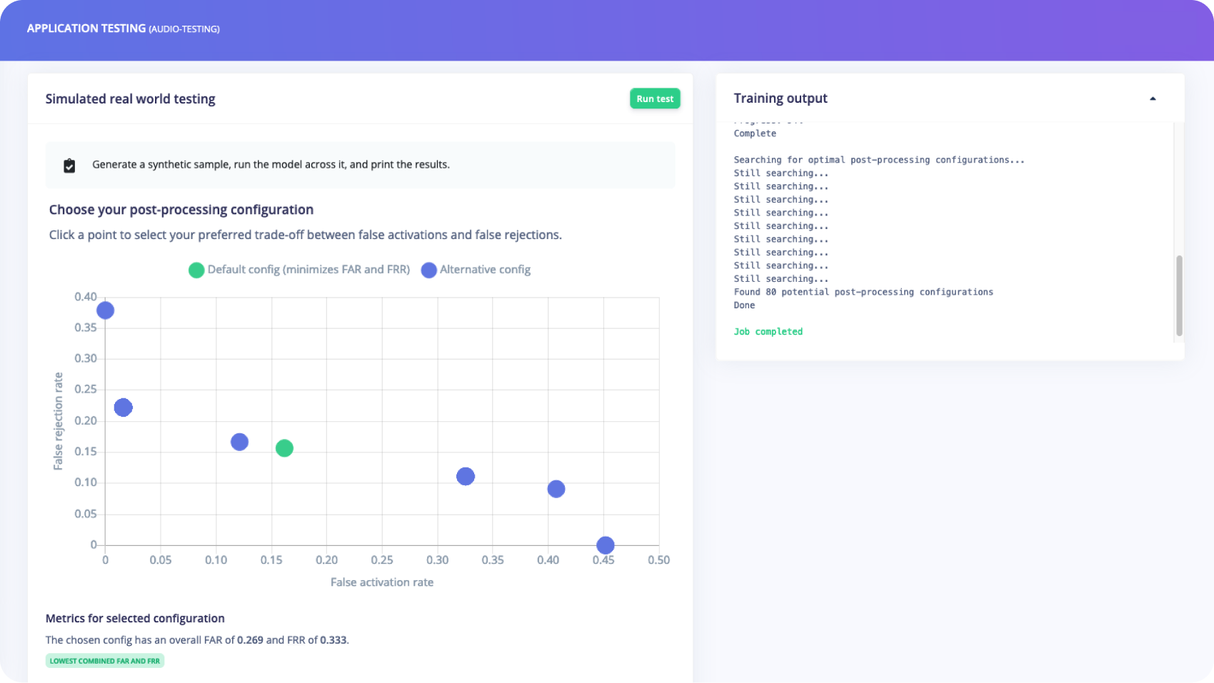
Go to market faster, with confidence
Test
Hardware-aware development
Full visibility across the whole ML pipeline
Test against real world data
Tune the algorithm to perform optimally

Slide 18
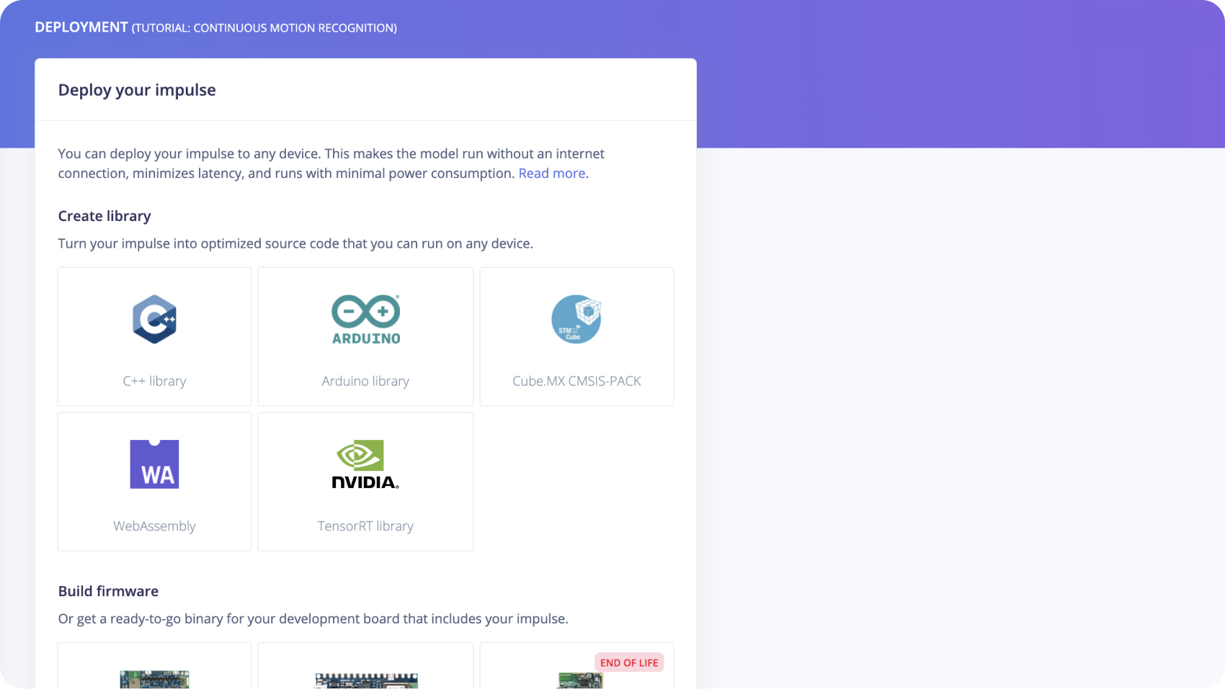
Deploy to any edge device with ease
Deploy
The largest silicon ecosystem
Award-winning compiler
Get access to full source code
Full firmware integration

Slide 19
Advanced Edge Impulse Features

Slide 20
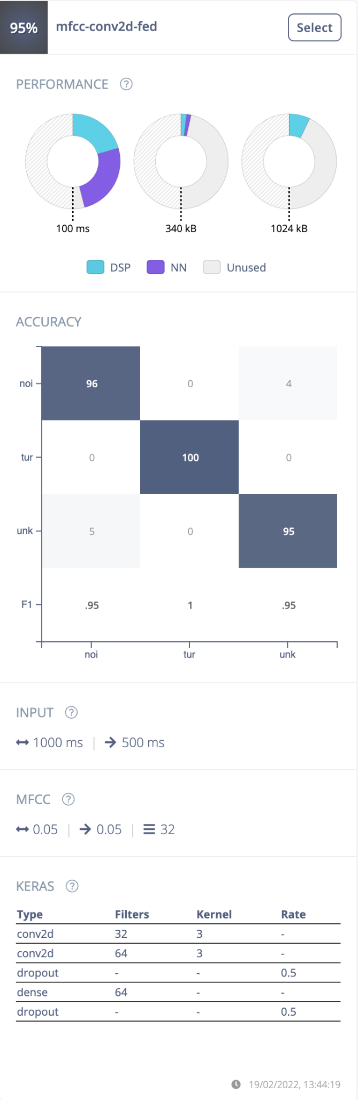
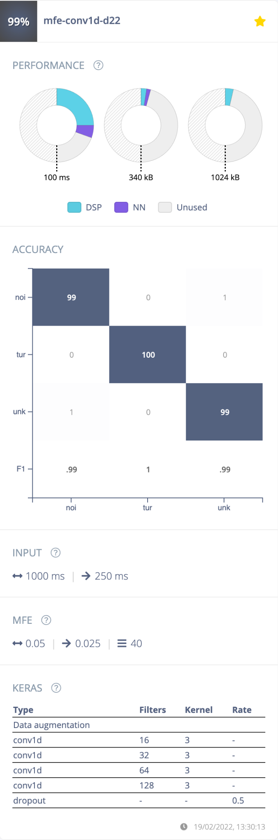
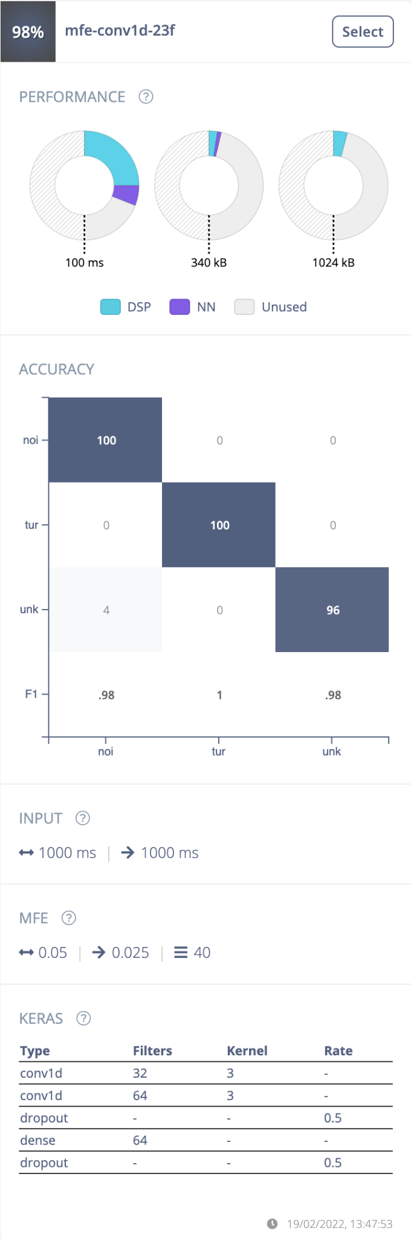
Optimize ML solutions with EON Tuner
Make the most of limited and heterogeneous compute
Find the perfect balance between feature extraction and model architecture
Recommendations based on real performance metrics
Built for constrained use cases to high end HW and complex use cases (e.g.: high-end CV)
Suggestions on optimal hardware target for use case

Slide 21
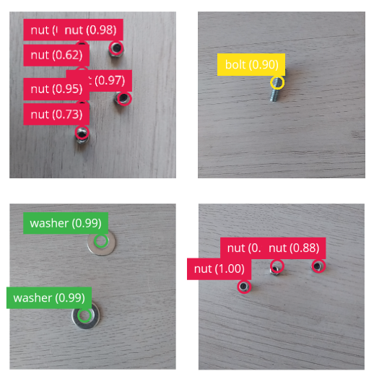
FOMO: Faster objects, more objects
Object detection on MCUs
10 fps on Arm Cortex-M7 MCU
Ultra fast on embedded Linux - 60 fps on RPi class
Better at detecting smaller and more numerous objects
Capable of segmentation and counting objects

Slide 22
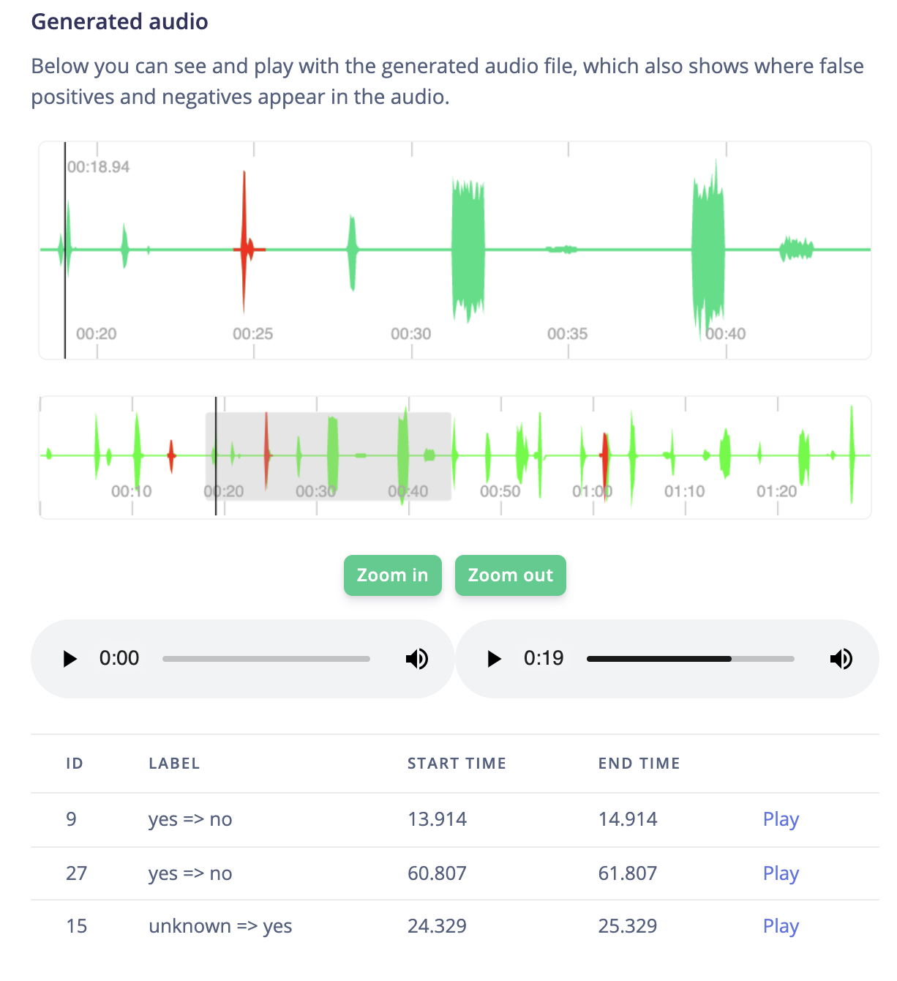
Calibrate your application at scale
Test on realistic samples: 24 hours of real world audio
Understand the impact of post-processing while accounting for device constraints and latency
Choose your ideal balance between false activations and false rejections
Leverage genetic algorithms to design optimal post-processing configuration

Slide 23
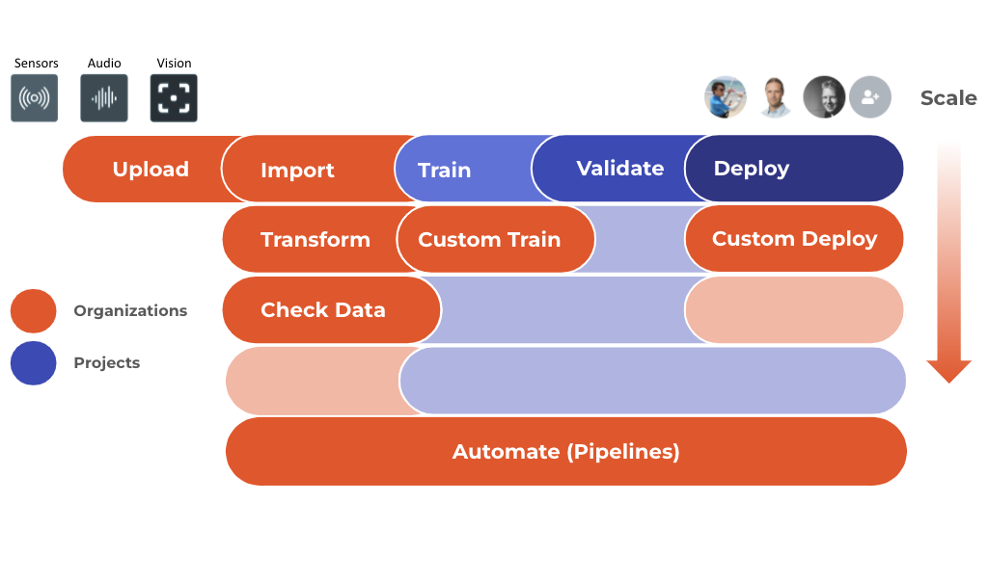
Advanced enterprise infrastructure
SSO for all of your enterprise’s users
Store, view and manage all of your enterprise’s data, projects and users
Unlock full team collaboration
Turn raw data into an ML ready dataset
Build advanced queryable datasets, with easy quality control
Save time and cost with cloud storage bucket integrations
Create upload portals to allow 3rd parties to upload data securely

Slide 24
So what can you do with it? 🤨

Slide 25



Remote Birding with the Raspberry Pi

Slide 26
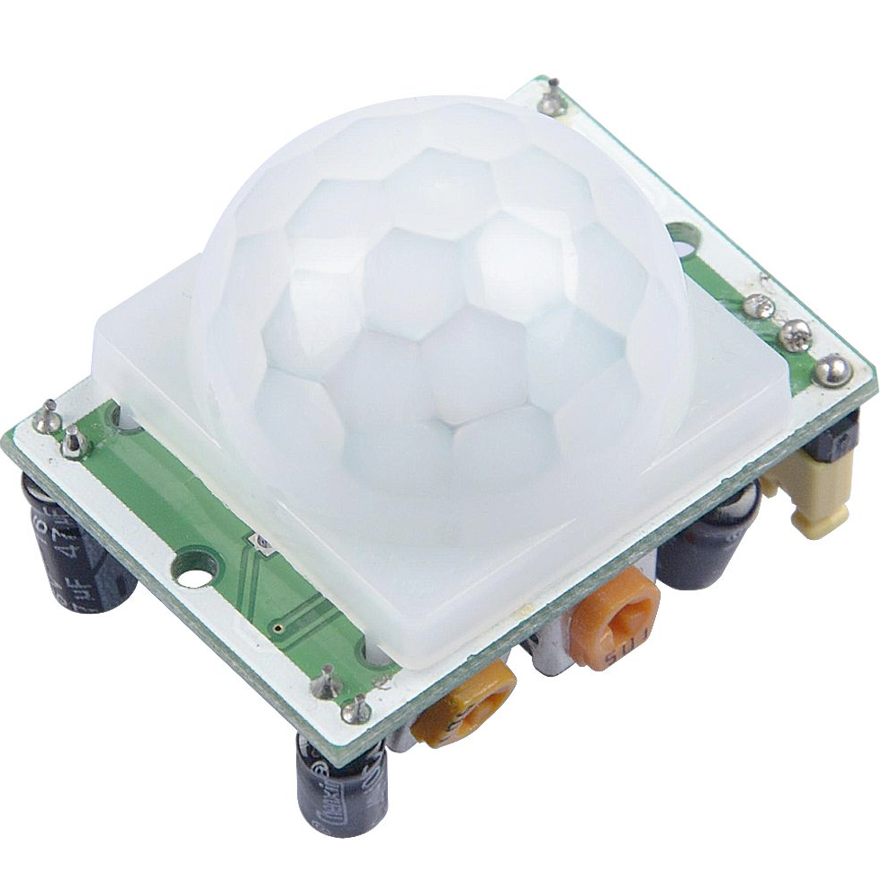
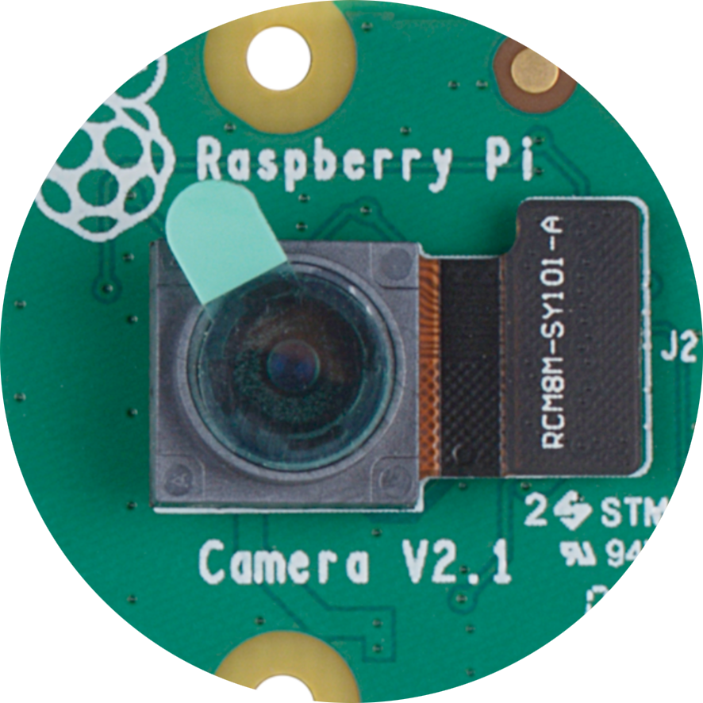




Remote Birding Workflow
PIR Motion Sensor
Detect motion from a bird at the bird feeder with infrared
TFLite
Use an ML model for birds around the world
Twilio SMS
Notehub.io securely routes the data to Twilio for an SMS
Pi Camera
Snap a quick picture of the bird
To the Cloud
Send data about the bird to Notehub.io

Slide 27
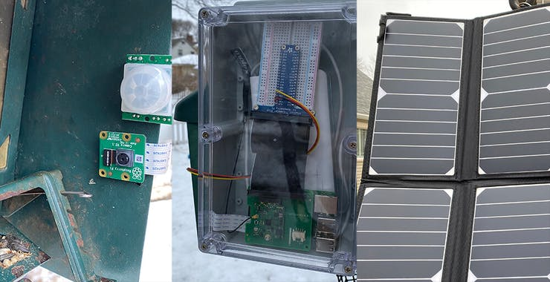
01

Slide 28
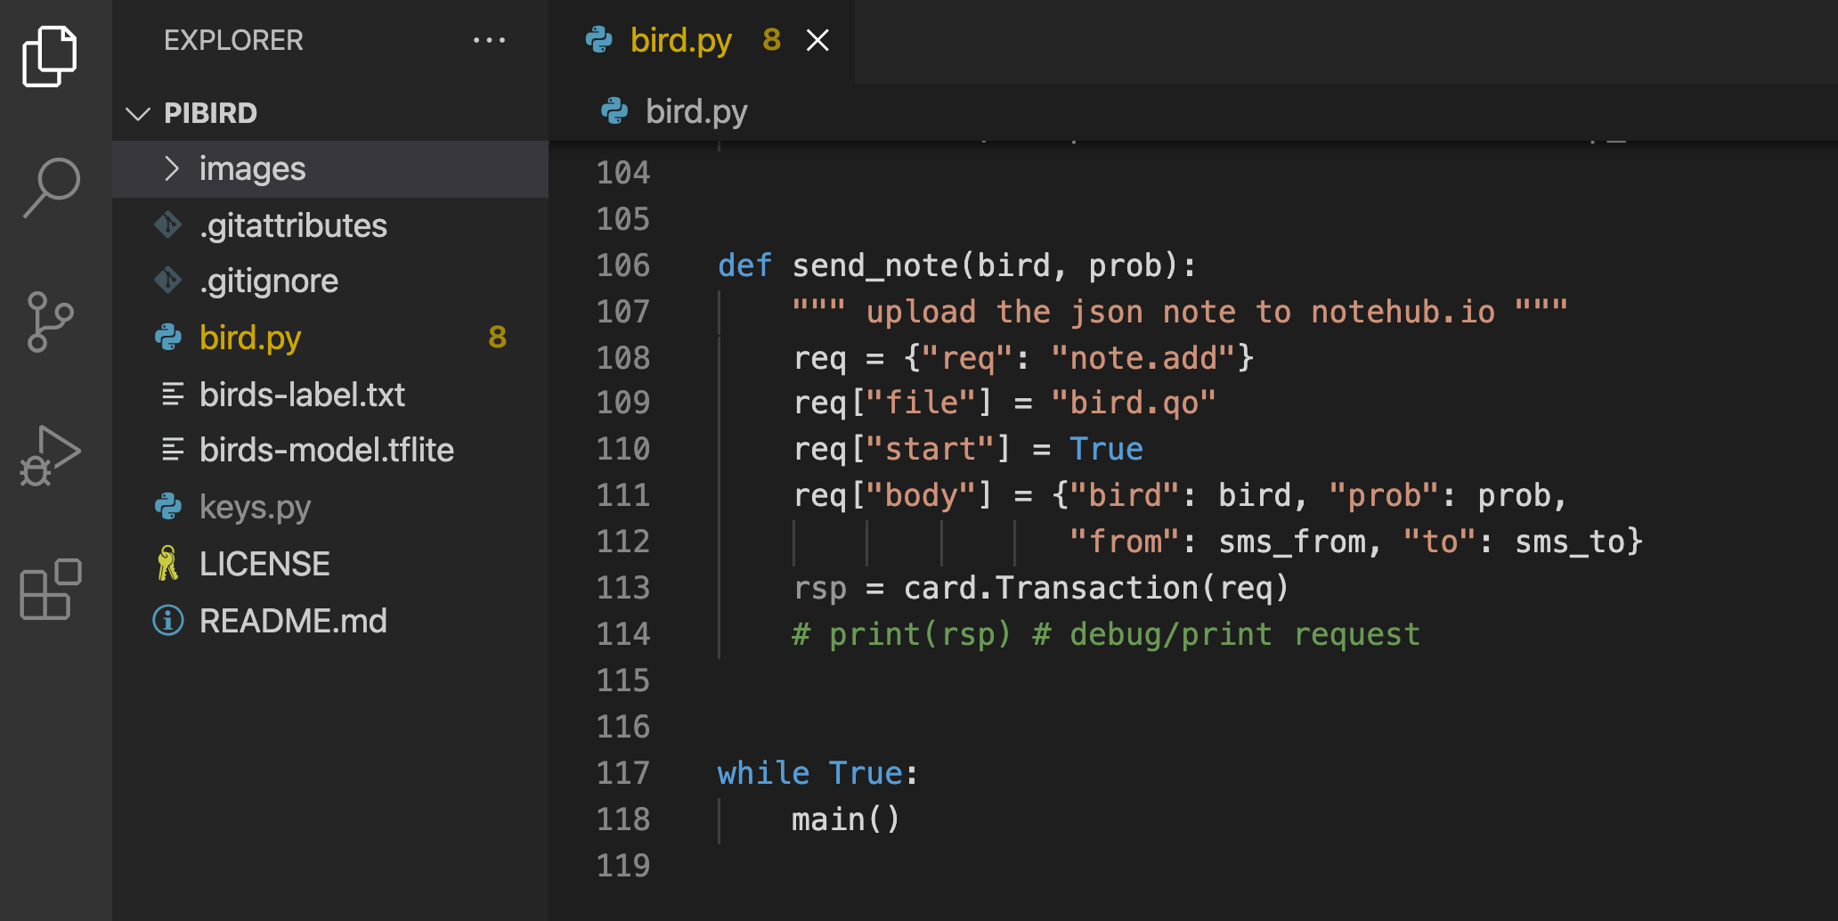
01

Slide 29
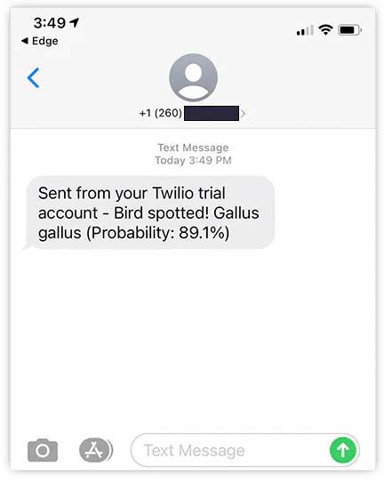
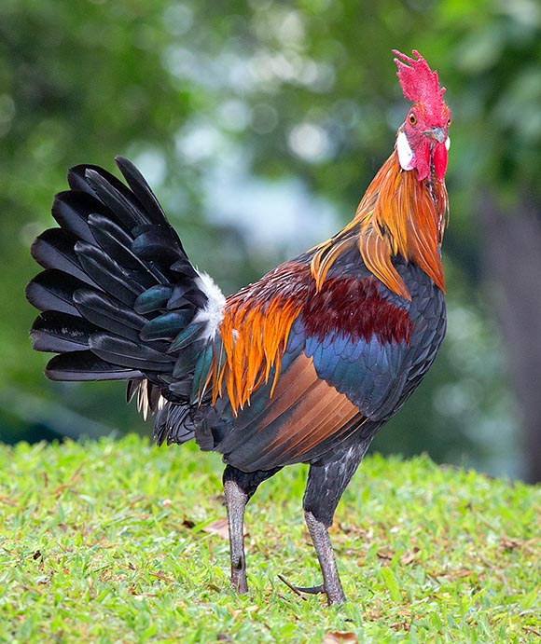

Slide 30



Build a Portable Speed Trap

Slide 31

Portable ”Speed Trap”
Uses ML to identify vehicles on the road
Uses a doppler radar sensor to gather speed
Uses a Notecard to relay aggregated data to cloud
Uses a cloud-based dashboard for reporting

Slide 32
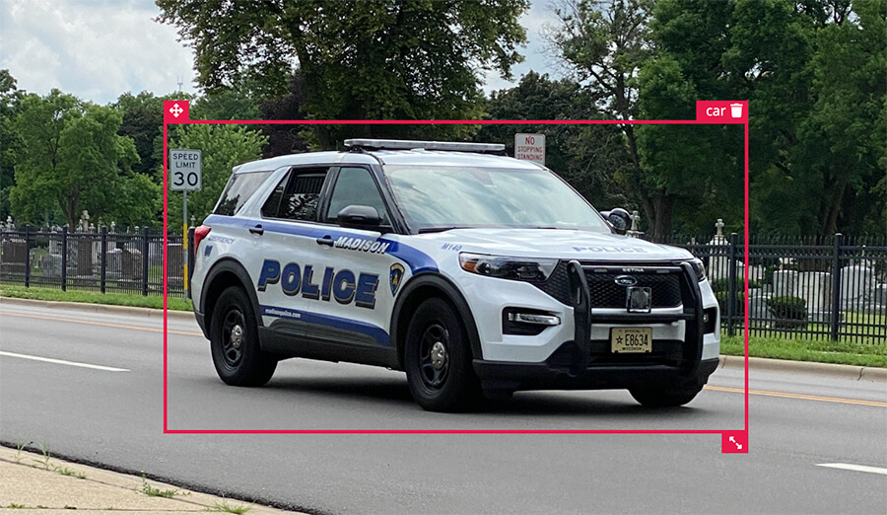

Slide 33
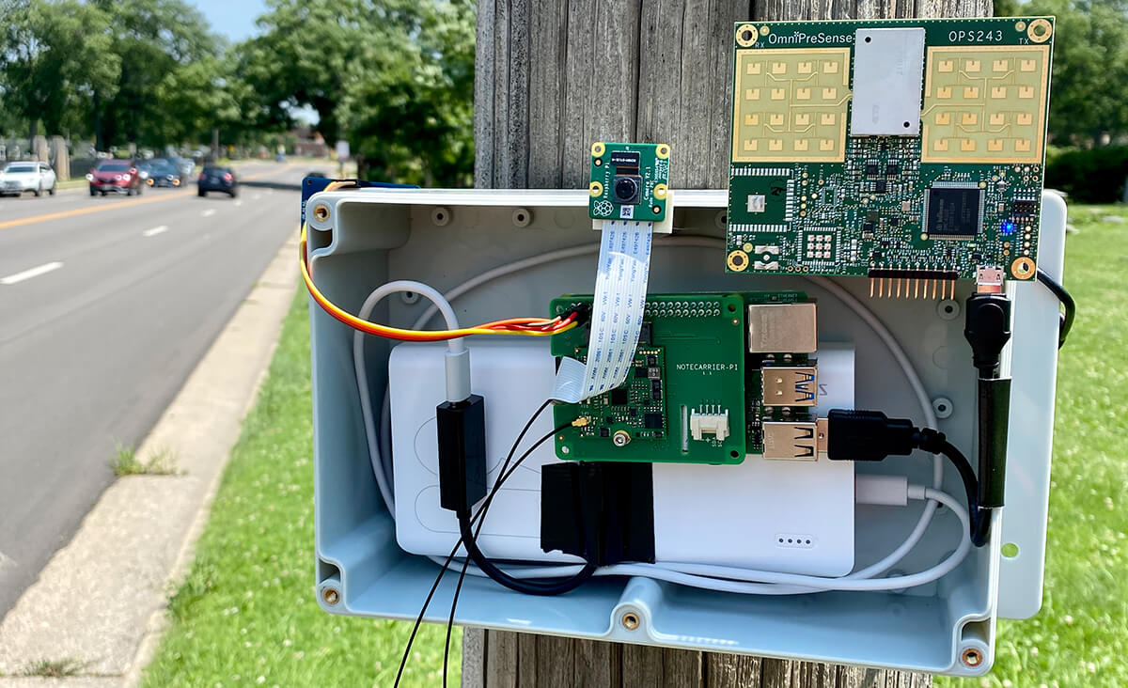

Slide 34
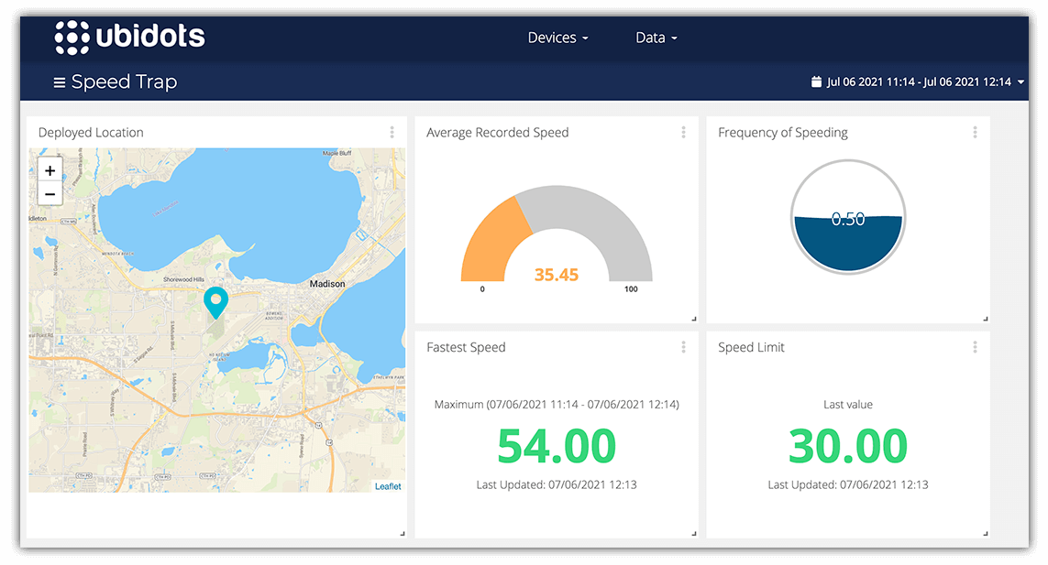

Slide 35


Thermal Image Anomaly Detection

Slide 36
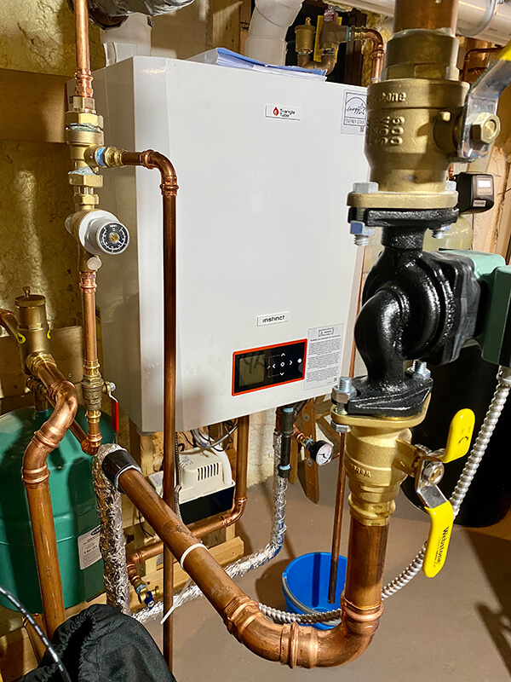

Slide 37
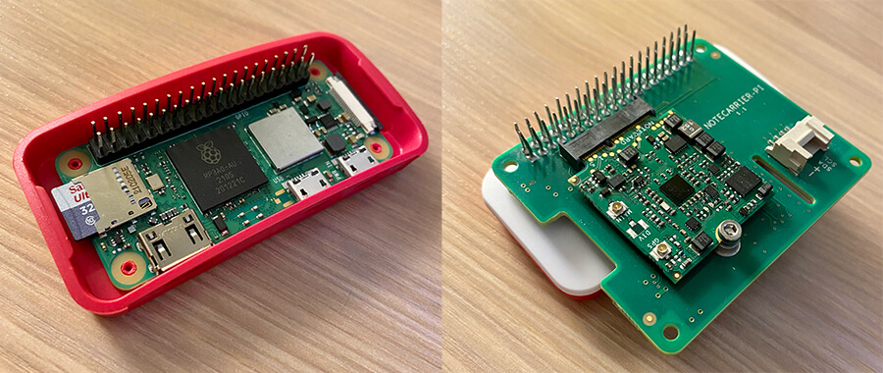

Slide 38
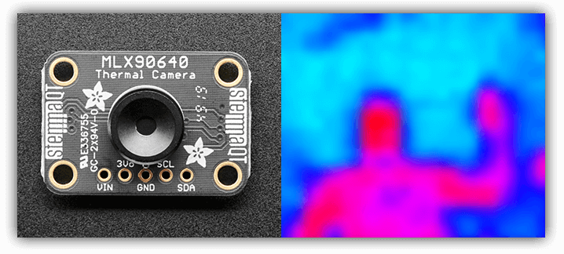

Slide 39
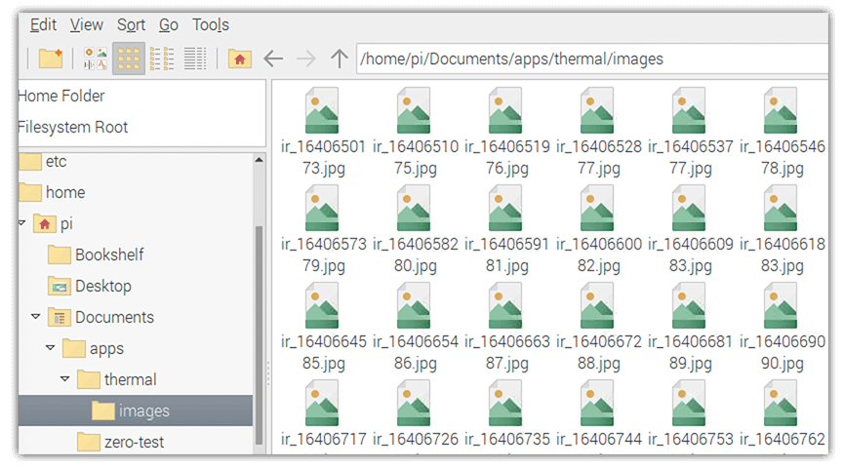

Slide 40
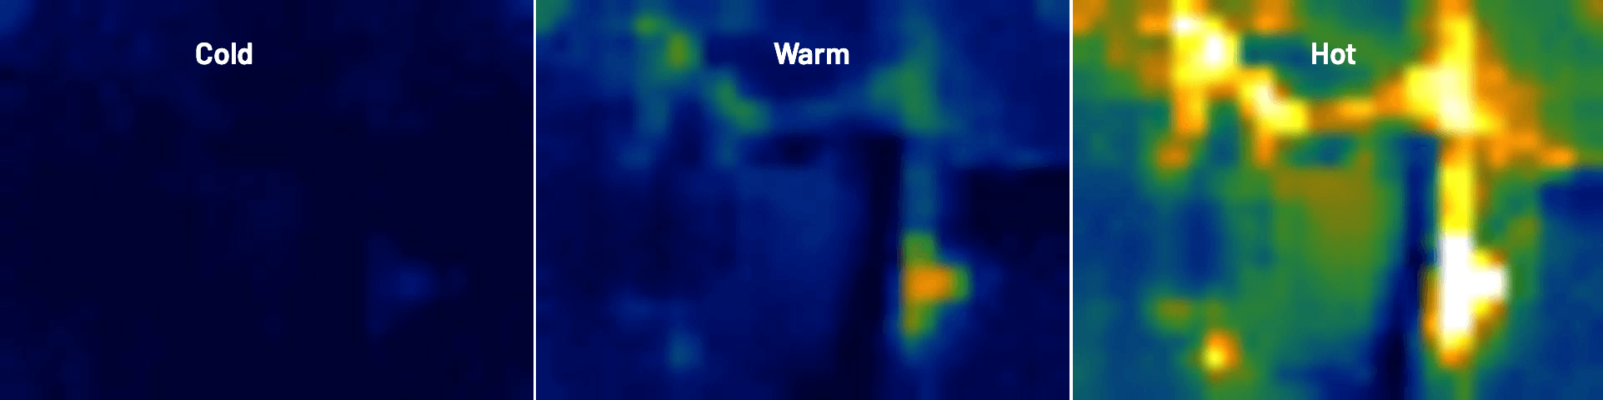

Slide 41
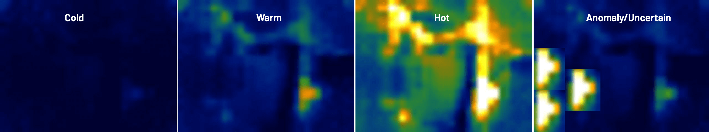

Slide 42
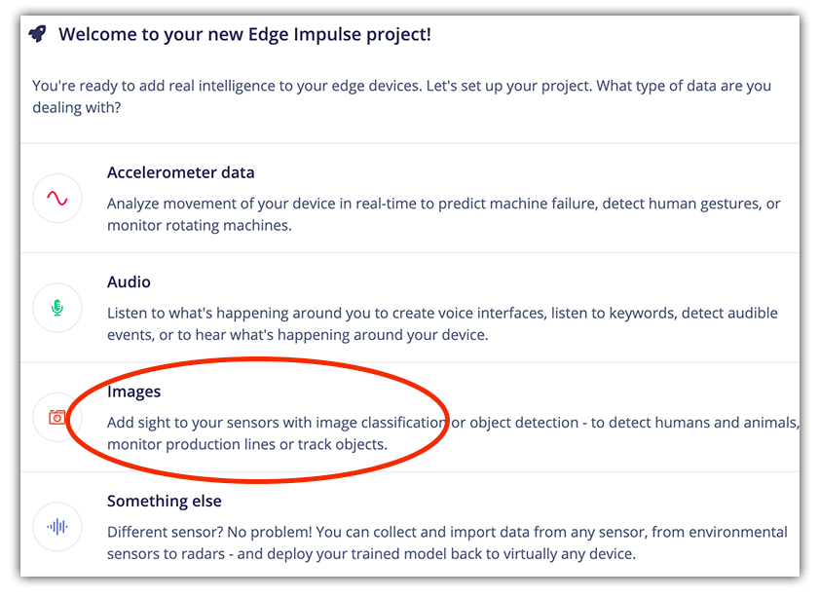
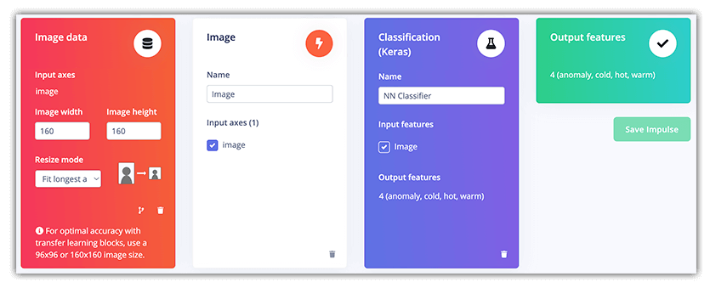
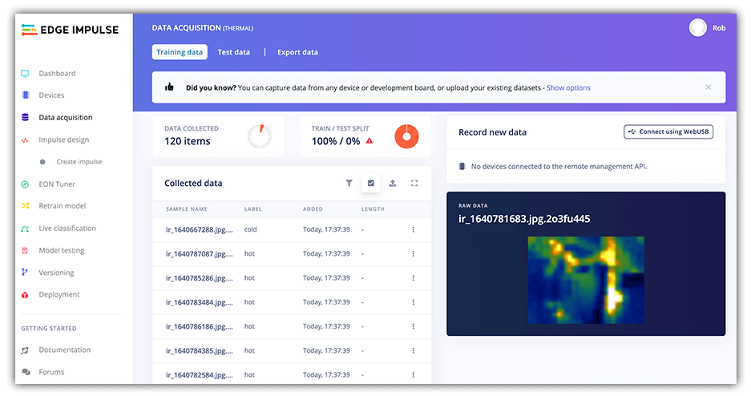
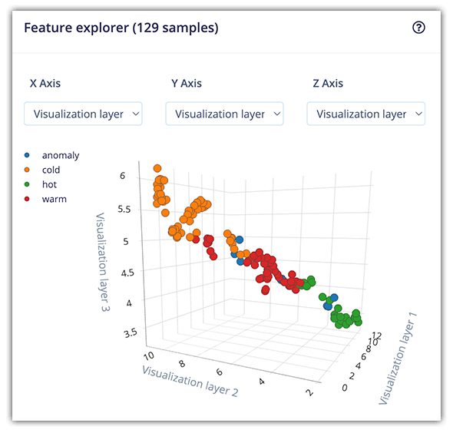

Slide 43
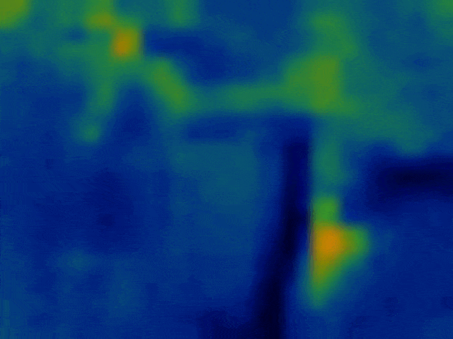

Slide 44
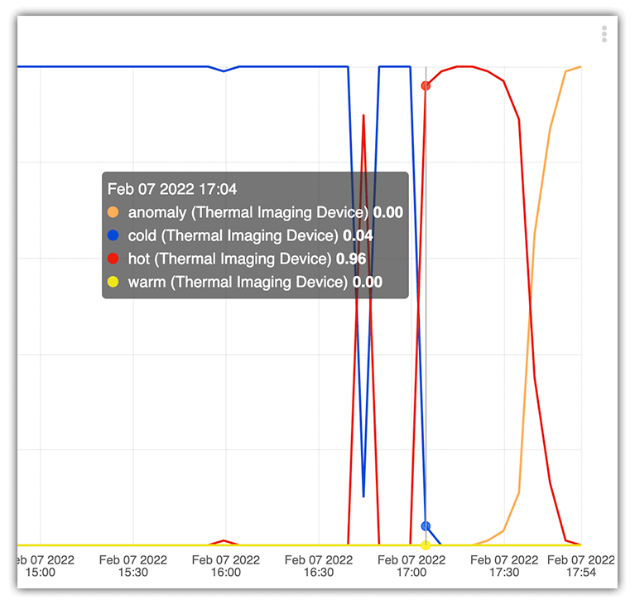

Slide 45


# initialize variables for Edge Impulse
runner = None
dir_path = os.path.dirname(os.path.realpath(__file__))
modelfile = os.path.join(dir_path, "modelfile.eim")
# initialize the Blues Wireless Notecard (blues.io)
productUID = keys.PRODUCT_UID
port = I2C("/dev/i2c-1")
nCard = notecard.OpenI2C(port, 0, 0)
# associate Notecard with a project on Notehub.io
hub.set(nCard, product=productUID, mode="periodic", outbound=30, inbound=720)
def main():
print('MODEL: ' + modelfile)
with ImageImpulseRunner(modelfile) as runner:
try:
model_info = runner.init()
print('Loaded runner for "' +
model_info['project']['owner'] + ' / ' + model_info['project']['name'] + '"')
labels = model_info['model_parameters']['labels']
# grab image from thermal camera
filename = thermal.takePicture()
img = cv2.imread("images/" + filename)
features, cropped = runner.get_features_from_image(img)
res = runner.classify(features)
if "classification" in res["result"].keys():
note_body = {}
for label in labels:
score = res['result']['classification'][label]
print('%s: %.2f\t' % (label, score), end='')
note_body[label] = round(score, 4)
note.add(nCard,
file="thermal.qo",
body=note_body)
while True:
main()
time.sleep(60 * 5)
hackster.io/blues-wireless

Slide 46
Lab! 🔨
Edge Impulse Studio Account
Node.js
Edge Impulse CLI
npm install –g edge-impulse-cli

